Slide 1
Airbnb: From Host to Superhost – Unlocking Excellence with AI
Members:​
Harshal Amin
Yash Kothari

Slide 2

Executive Summary
Airbnb Host Coach: Empowering Growth with GenAI
Key Findings
• Personalized AI recommendations enable hosts to achieve Superhost status by improving performance metrics like 5-star reviews and occupancy rates.
• Dynamic pricing and booking-to-revenue strategies maximize host profitability.
• Growth Potential Index (GPI) identifies high-growth neighborhoods for expansion, driving market balance and growth.
• Superhosts enhance Airbnb’s reputation and guest satisfaction, fueling platform loyalty.
Proposal
A scalable, data-driven solution that fosters Superhosts, increases revenue, and strengthens Airbnb's leadership in the short-term rental market.
Airbnb Host Coach positions Airbnb for sustainable growth by leveraging AI-powered recommendations and neighborhood insights using GenAI over superhost data and predictive analytics. For the scope of this project, we prepare and process the data and develop a predictive model. Next phase will include integrating GenAI over the predictions and insights to coach hosts.

Slide 3
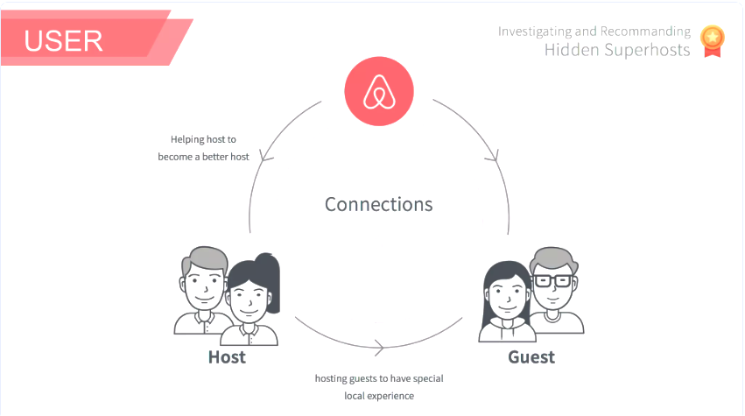
Business Problem
Core Issues
1. Hosts lack actionable insights to achieve Superhost status and optimize revenue.
2. Limited tools for identifying high-growth neighborhoods for expansion.
3. Market imbalances due to oversaturation in some areas and missed opportunities in others.
Impact on Airbnb
• Revenue loss from underperforming hosts.
• Guest dissatisfaction due to lower-quality listings.
• Competitive threats from platforms like Vrbo and Booking.com.
Opportunity
The Airbnb Host Coach leverages AI and data analytics to provide hosts with personalized insights, enabling better performance, enhanced guest experiences, and sustainable market growth.

Slide 4
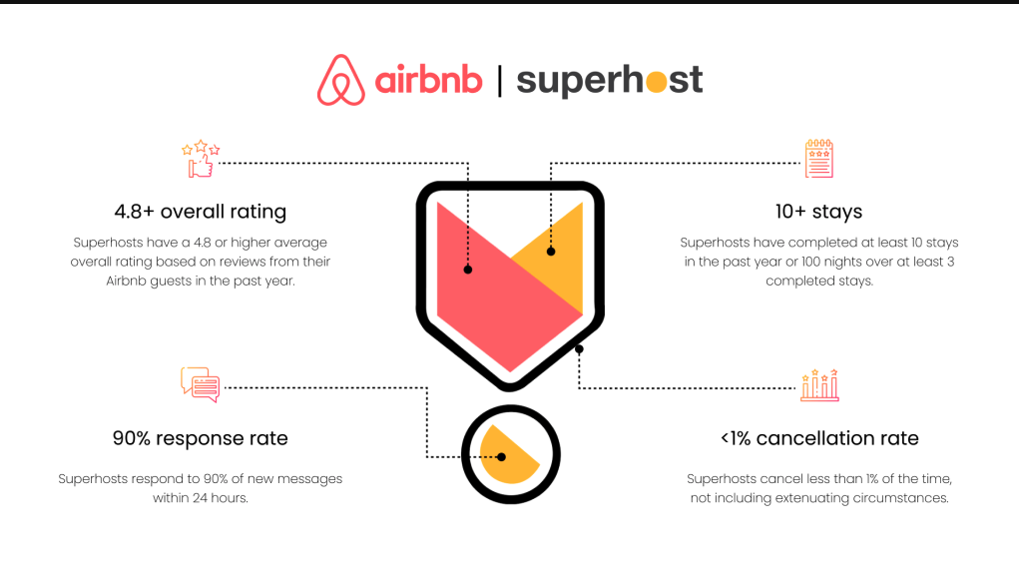

Slide 5
Exploratory Data Analysis

Slide 6
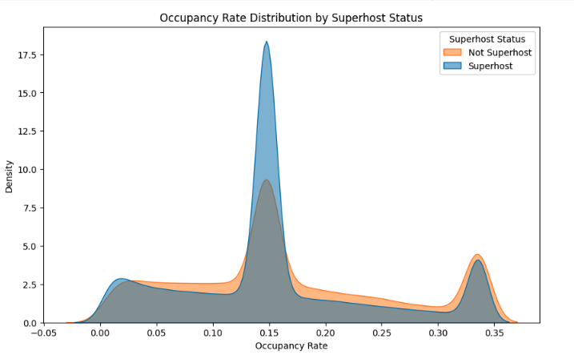
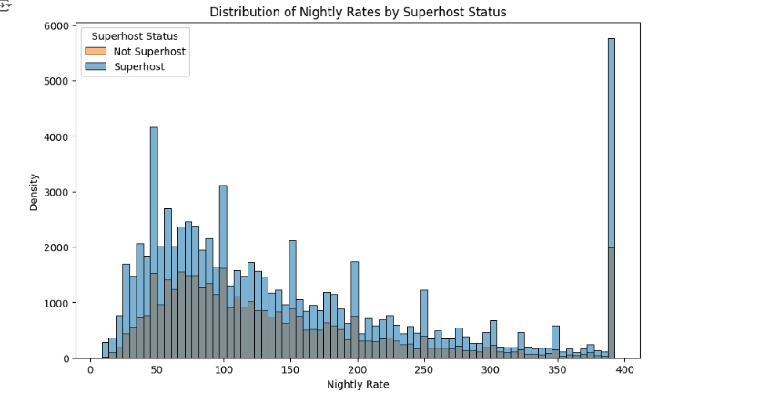
EDA
Superhosts generally achieve higher occupancy rates compared to non-superhosts.
Superhosts generally charge higher nightly rates compared to non-superhosts, showcasing their ability to command a premium.
Both groups exhibit a high density of properties in the lower price range (< $100).

Slide 7
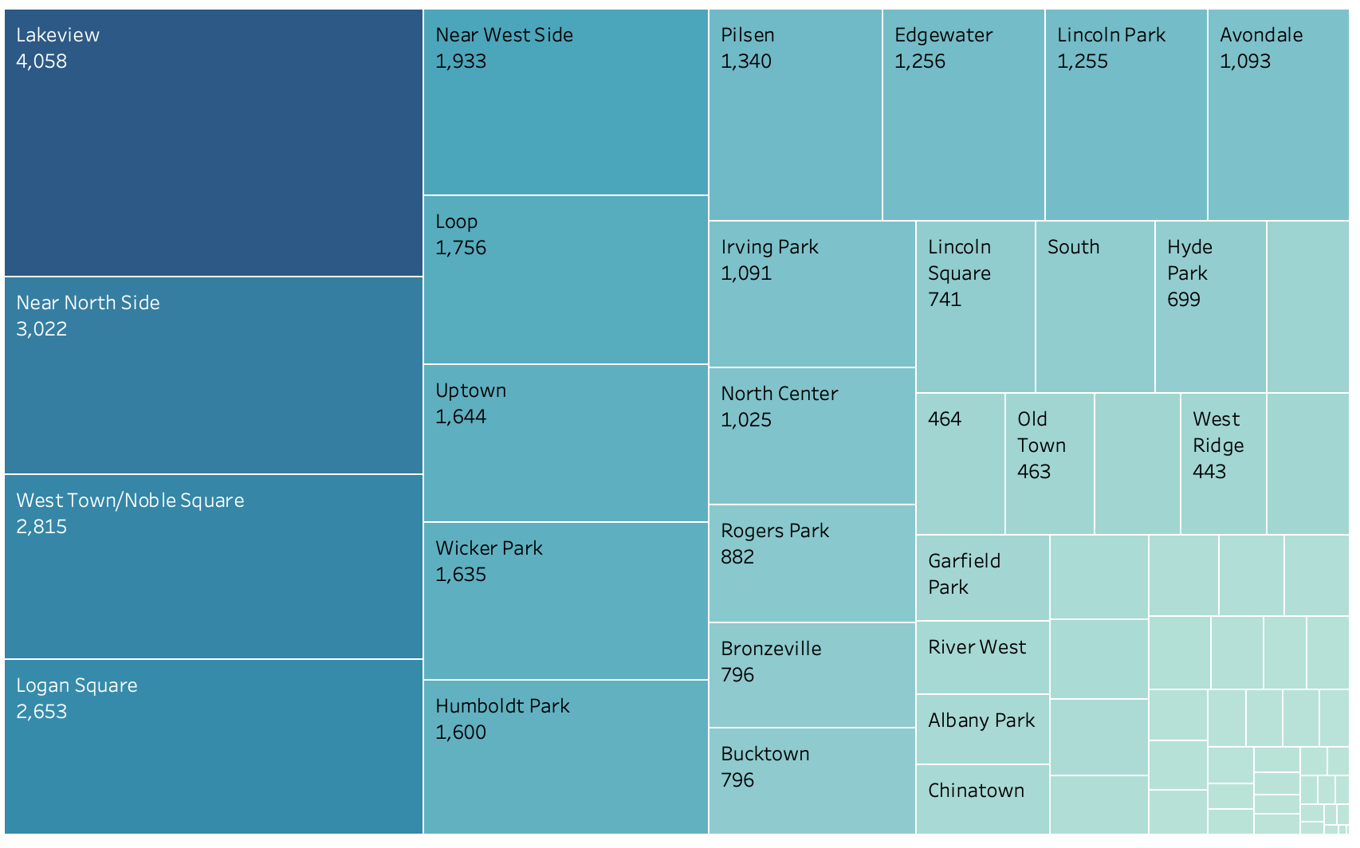
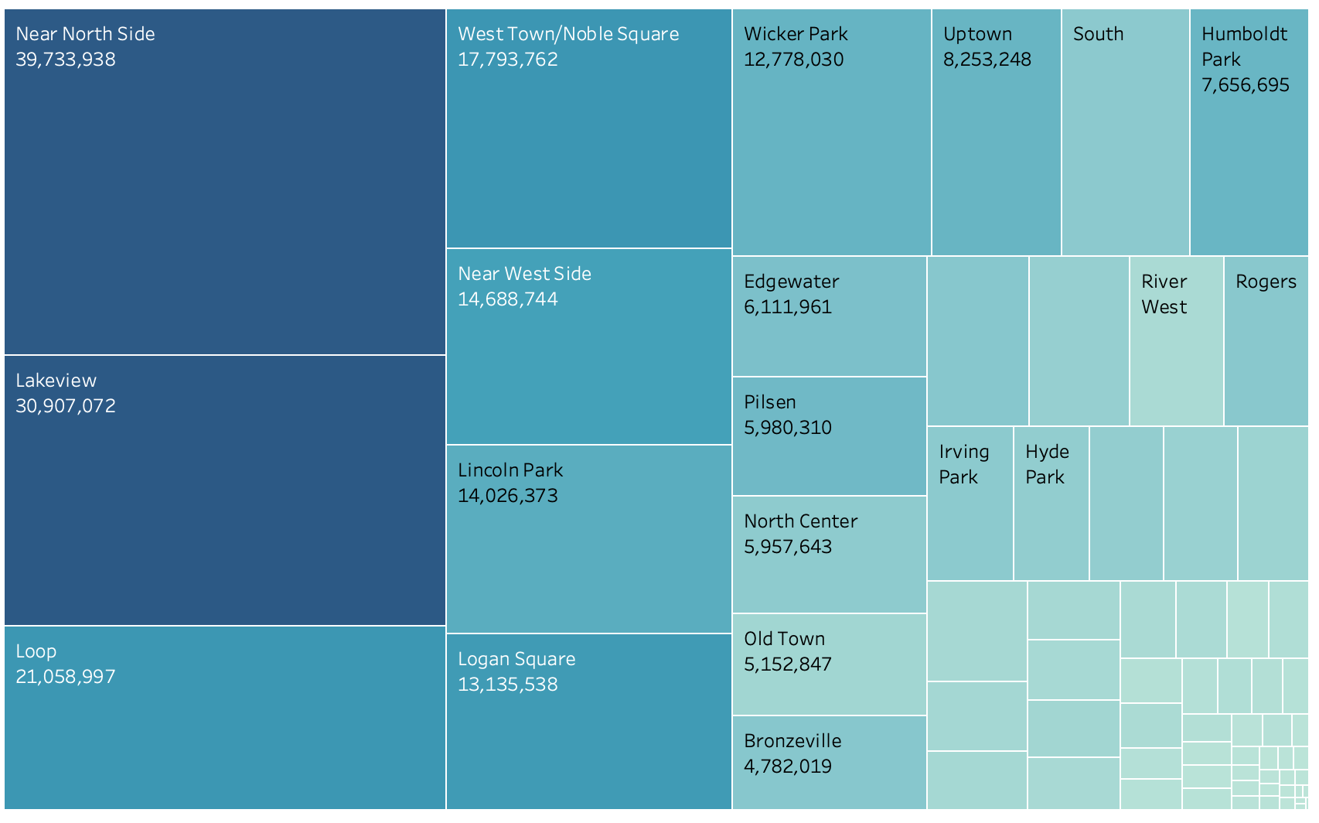
EDA
Superhosts Count for a Neighborhood does not determine the Revenue of that Neighborhood
Superhost Count by Neighbourhood
Revenue Sum by Neighbourhood
Highest no. of Superhosts in Lakeview followed by Near North Side & West town/ Noble Square
Near North Side and Lakeview generate the highest revenue, demonstrating their importance in the Airbnb market.

Slide 8
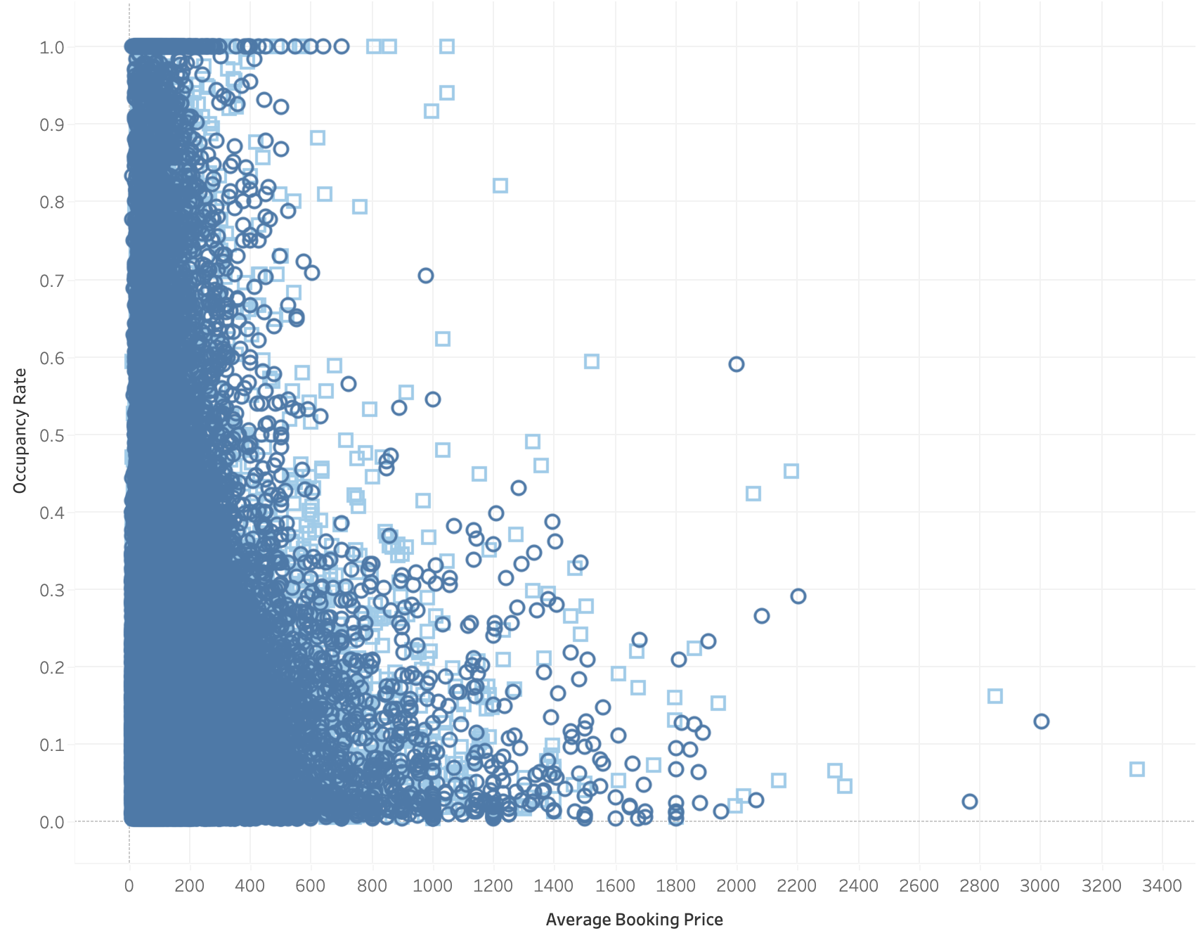
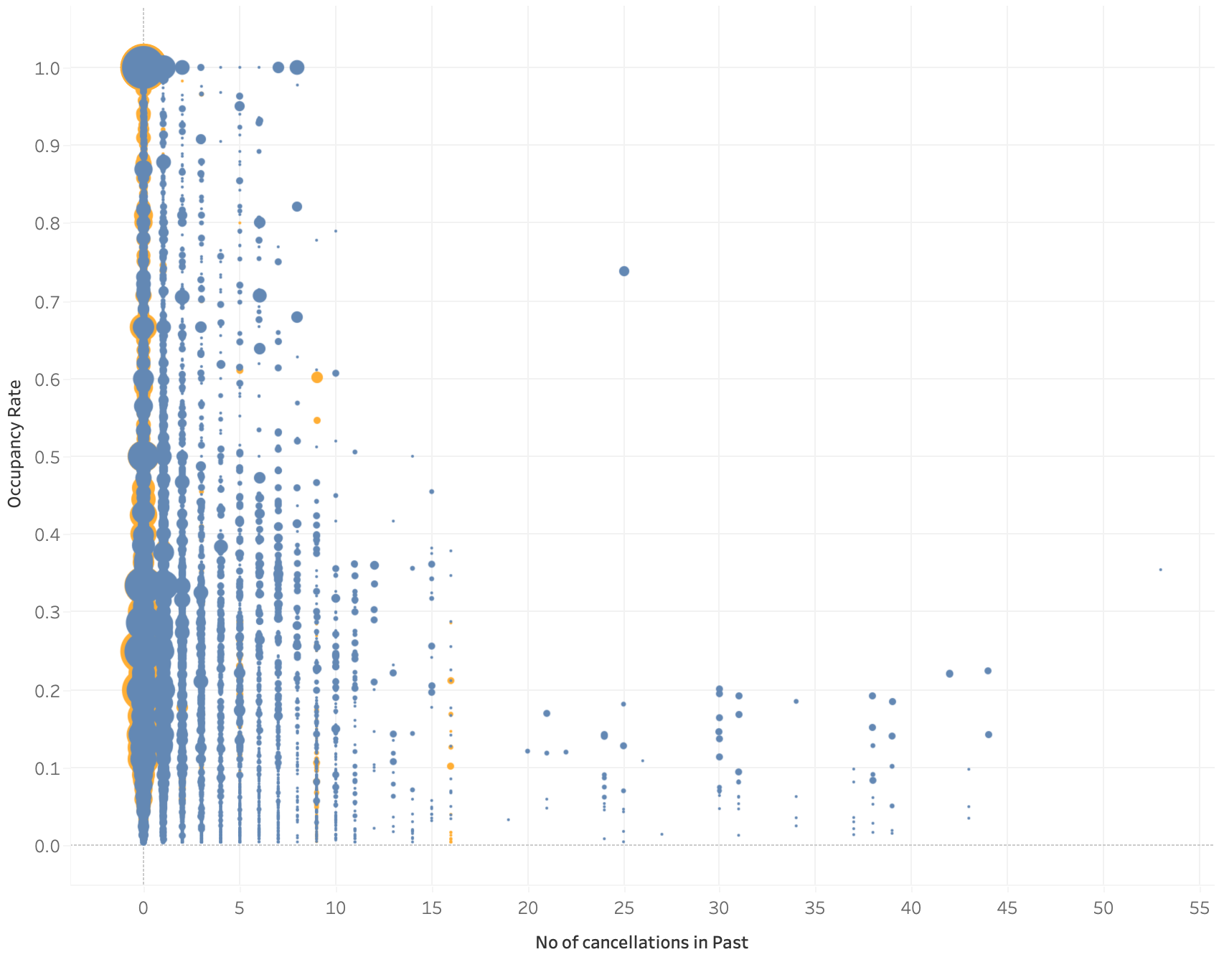
EDA
Increase in the Avg Booking Price decreases occupancy rate for both hosts and super hosts, Highest occupancy rate for the booked days average price range $600- $1400
As number of cancellations increases occupancy rate decreases and so does the revenue for both Hosts & Superhosts . (Bubble size here is as per the revenue of the host.)

Slide 9
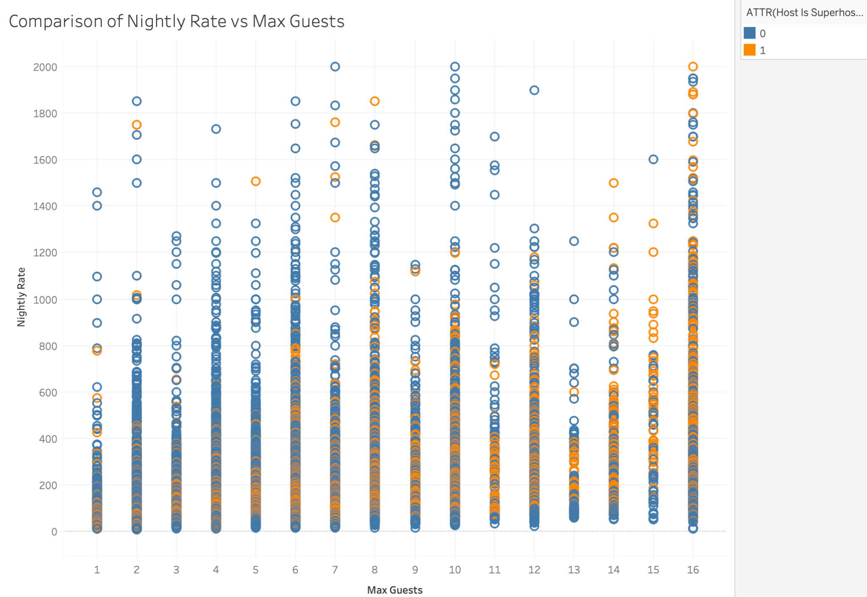
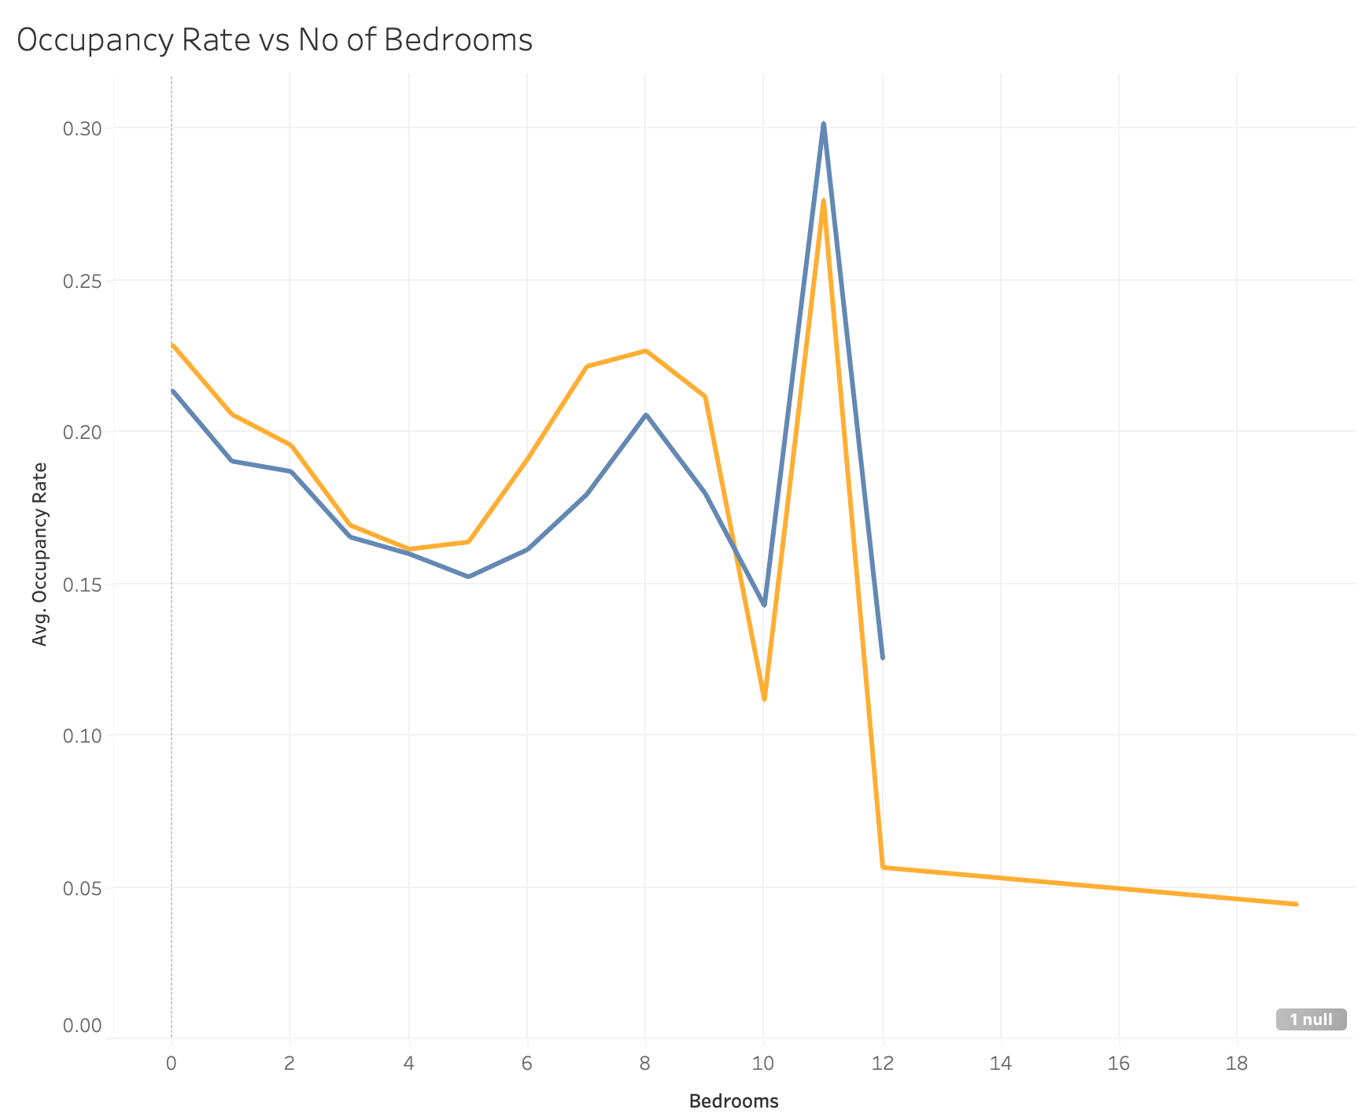
EDA
Increase in the number of guests increases nightly rate for both hosts & Superhosts. For higher number of bedrooms there are more Superhosts than hosts.
Occupancy rate for Superhosts is generally higher than host across all periods. Occupancy Rate is maximum for the number of bedrooms at 11 for both hosts & Superhosts beyond which it starts decreasing drastically (this could be due to the decrease in demand as well. )

Slide 10
DATA PREPARATION

Slide 11
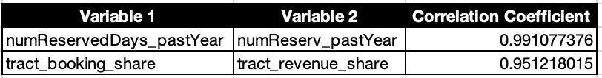
DATA PREPROCESSING
Collinearity and Outlier Detection
Data Source - Airbnb_Chicago.csv
Outliers Observed: Yes
Method of Detection: Boxplot Analysis
Variables with outliers: 26
Method of Treatment: Winsorization by capping lower and upper bounds
Outcome -
Normalized the dataset for 26 variables by capping values between 5th and 95th percentile
No need for removal of any variable due to outliers.
Collinearity Observed: Yes
Method of Detection: VIF
Total Collinear Variables: 2
Collinearity Threshold: > 0.95
Outcome - Removed the correlated variable to reduce variance in the model
Outlier Detection
Collinearity Detection

Slide 12
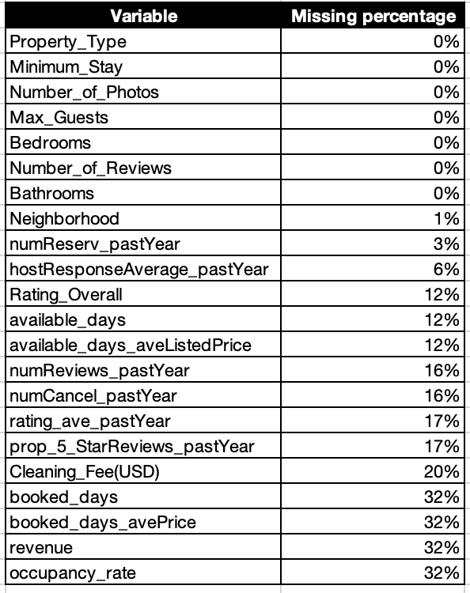
DATA PREPROCESSING
Handling Missing Values - A significant proportion of dataset contains null values
1. Numerical Columns
Skewness Check:
|Skew| < 1 → Mean Imputation (normal-like distribution)
|Skew| ≥ 1 → Median Imputation (to handle outliers)
Implementation: Missing values in each numerical column were imputed with the mean or median accordingly.
2. Categorical Columns
Approach: Imputation using Mode or 'Unknown'.
Mode Check:
If mode frequency > 50% → Mode Imputation
Else → 'Unknown' Imputation
Implementation: Missing categorical values are filled with the mode if it's dominant, otherwise, they are replaced with 'Unknown'.
Dropped null records
Imputation Method

Slide 13
DATA PREPROCESSING
Feature Selection & Data Ingestion | Removal of irrelevant features, to increase reliability
Objective: Convert categorical data to numeric while preserving its impact on the target.
Methods & Treatment:
Target Encoding: Encoded Neighborhood using the target’s mean.
One-Hot Encoding: Encoded low-cardinality categorical features into binary columns.
Mutual Information: Dropped features with low MI (< 0.005) relative to the target.
Outcome:
Converted categorical features to numeric.
Objective:Address class imbalance to avoid model bias.
Methods & Treatment:
SMOTE: Oversampled the minority class.
Train-Test Split: Split 80/20 with stratification to preserve class distribution.
Outcome:
Balanced target classes for better predictive performance.
Reduced noise, retained key predictors.
Objective: Eliminate noise and reduce dataset complexity.
Methods & Treatment:
Drop Columns: Removed Airbnb Host ID, Airbnb Property ID, and Scraped Date.
Low Variance Filter: Removed features with variance < 0.01.
Feature Importance: Used Gradient Boosting to drop features with importance < 0.005.
Outcome:
Reduced irrelevant features, improved model efficiency.
Categorical Features
Handling Imbalance
Handling Irrelevance

Slide 14
DATA MODELING

Slide 15
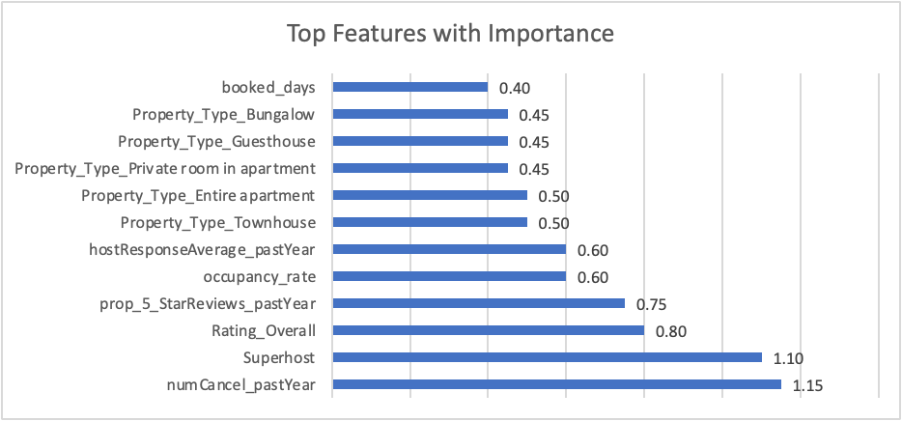
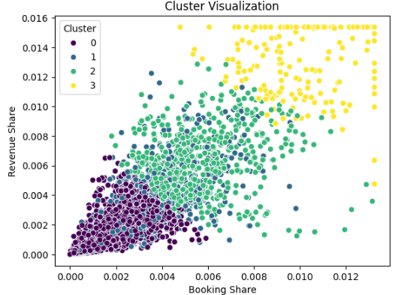
Models Built and Their Purpose
Gradient Boosted Decision Tree (GBDT) (Best Performance):
Purpose: Predicts Superhost probability based on guest ratings, occupancy rates, cancellations.
Strengths:
Captures non-linear relationships in data.
Robust against diverse Airbnb datasets.
Performance:
AUC-ROC Score: 0.9857 (excellent predictive power).
Precision & Recall: Both at 94%, ensuring reliable predictions.
Top Features - numCancel_pastYear, Superhost (in Past), Rating Overall
Clustering (KMeans):
Purpose: Groups properties into clusters (e.g., high-growth, steady-growth, low-growth).
Features Used: Booking-to-revenue ratio, occupancy rate, Superhost density ratio.
Key Output: Four clusters (optimized via Elbow Method) for market segmentation.

Slide 16
Growth Potential Index (GPI) and Model Integration
Title: Growth Potential Index (GPI) and Integration
Growth Potential Index (GPI):
Purpose: Combines GBDT predictions, cluster insights, and host performance metrics.
Range: 0.0 (low growth) to 1.0 (high growth).
Key Strength: Provides a unified metric for growth potential, enabling personalized recommendations.
Integrated System Workflow:
GBDT: Predicts Superhost probability as a foundational metric.
Clustering: Contextualizes hosts within market-based clusters for localized insights.
GPI: Synthesizes predictions and cluster data for actionable insights.
Outcome: Hosts receive tailored strategies for revenue growth, pricing, and Superhost qualification.
Key Insights:
High-GPI hosts receive expansion or pricing optimization advice.
Low-GPI hosts are guided to improve guest ratings, occupancy, and revenue strategies.

Slide 17
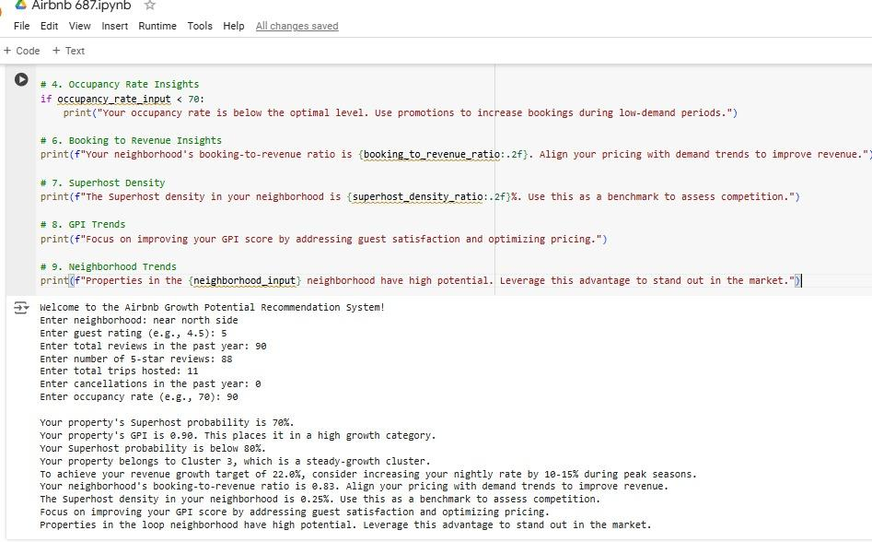
Final Product

Slide 18
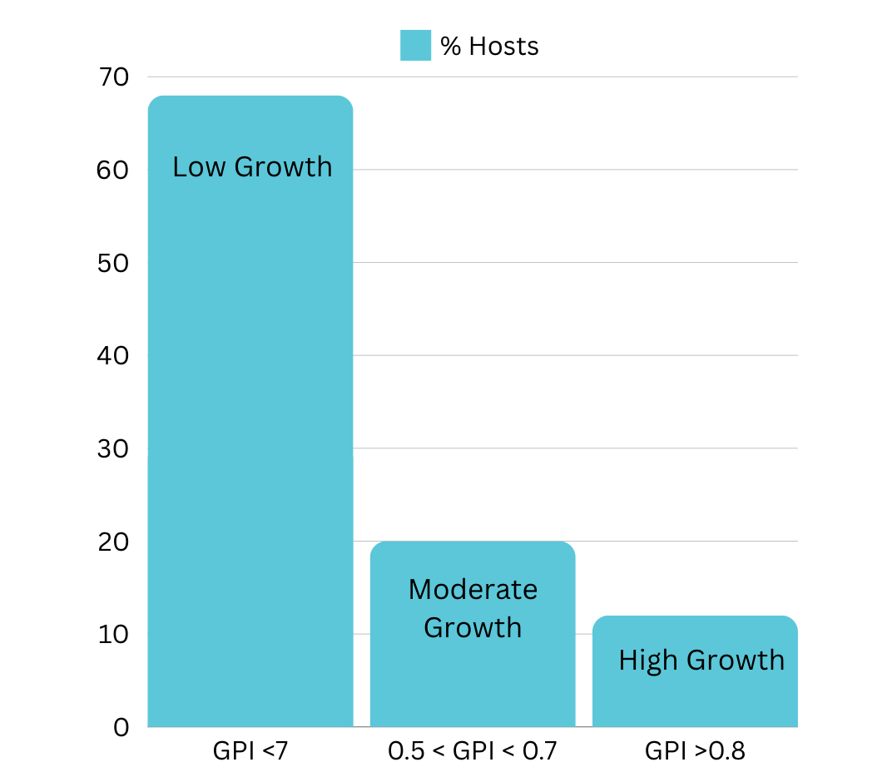
Summary
Key Results
Superhost Probability: Our system predicts am 80% likelihood of 22 host to achieve Superhost status.
Growth Potential Index (GPI): The GPI highlights the potential growth of a property using six key factors: rating, occupancy, cluster growth, superhost probability, and booking/revenue performance.
Clustering: Properties are grouped into "High-Growth", "Moderate-Growth", and "Low-Growth" clusters to identify growth opportunities.
User-Specific Recommendations: Our system provides hosts with clear, personalized recommendations to increase revenue, optimize bookings, and achieve Superhost status.
How to Interpret the Results
Superhost Probability: If the score is above 80%, the host has a strong chance of becoming a Superhost. If the score is below 50%, the system offers improvement recommendations.
Clustering: The property is assigned to one of four clusters (e.g., Cluster 1, 2, 3, or 4). Each cluster has unique characteristics that influence growth potential.

Slide 19
Robust Results
Model Accuracy & Performance
Gradient Boosted Decision Tree (GBDT)
AUC-ROC Score: 0.9857 (very high predictive accuracy), Data split into 80% training and 20% testing for model validation.
Cross-Validation: 3-Fold Cross Validation to ensure consistent performance across data splits
Hyperparameter Tuning: RandomizedSearchCV used to optimize parameters like learning rate, max depth, etc.
Clustering: Clustering was performed using KMeans Elbow Method to ensure the right number of clusters (optimal k=4).
Real-World Application
Predicts Superhost status, offers personalized recommendations, and provides insights into cluster-level growth potential for Airbnb hosts.
This system can scale to support Airbnb hosts globally, with tailored insights for each market.

Slide 20
Implications for stakeholders
Impact on Airbnb Hosts (Primary Users)
Achieve Superhost Status: Personalized guidance on how to qualify for Superhost status (e.g., increase trips, reduce cancellations, get more 5-star reviews).
Revenue Growth: Data-driven pricing advice to increase nightly rates during peak demand.
Dynamic Booking Strategies: Clustering identifies growth potential, enabling hosts to expand into high-growth areas.
Real-World Example: "Your property has a GPI of 0.83 (High-Growth). Focus on increasing 5-star reviews and consider raising prices during peak demand periods."
Impact on Airbnb (Platform)
More Superhosts: More Superhosts = more bookings, higher customer satisfaction, and stronger brand loyalty.
Revenue Growth: More host revenue = higher Airbnb commissions.
Expansion of High-Growth Clusters: Airbnb can use GPI trends to focus on expanding into high-GPI neighborhoods.
Impact on Guests (Travelers)
Better Guest Experiences: As more hosts become Superhosts, guest experiences improve.
More Affordable Options: Hosts offer dynamic pricing, giving guests more affordable options during low-demand periods.
Real-World Example: "More Superhosts = better guest satisfaction = higher guest retention."

Slide 21
Market-Level Impact and Competitive Edge
Competitor Threat (Vrbo, Expedia, Booking.com)
Loss of Market Share: Airbnb becomes the "go-to platform" for hosts and guest satisfaction, leading to a competitive edge.
Platform Lock-in: Hosts feel "locked in" due to the system’s valuable insights.
Competitor Reaction: Competitors like Vrbo may try to copy the system, but data-driven guidance and network effects give Airbnb a first-mover advantage. "If Airbnb rolls out this system early, it will create a competitive moat that is difficult to breach."
Real Estate Investors
Neighborhood Growth Potential: GPI highlights neighborhoods with the best investment potential.
Market Insights: Identifying emerging areas before they become popular gives Airbnb a competitive edge. "Properties in the 'Lakeview' neighborhood have a GPI of 0.85, indicating high growth potential for real estate investors."
Implications for the Short-Term Rental Market
Expansion of Supply: Airbnb can encourage new hosts to enter high-GPI clusters, ensuring an adequate supply of listings in areas of growing demand.
Revenue Uplift: Data-driven dynamic pricing leads to revenue growth, which affects all stakeholders in the short-term rental market.

Slide 22
References
Articles:
https://simplyvinita.medium.com/how-i-built-a-profitable-airbnb-business-from-new-host-to-superhost-a4bb3594d3f2
https://techcrunch.com/2024/02/13/airbnb-plans-to-use-ai-including-its-gameplanner-acquisition-to-create-the-ultimate-concierge/
Data Description: https://purdue.brightspace.com/d2l/le/content/1148723/viewContent/17995963/View
GenAI:
https://chatgpt.com/c/674102a9-ecf8-800b-be34-fca212b67838

Slide 23
THANK YOU!

